Slide 1
Watson Health Insurance (WHI)
By Marwa Talaat

Slide 2
Introduction
Watson Health Insurance (WHI) is a growing private healthcare insurance provider.
It wants to improve the health insurance industry by providing better care and offerings to its patients.
Center for Disease Control (CDC) conducts surveys to understand the latest demographic, health, and fitness trends.
The results and recommendation from this survey will be provided with recommendations back to the Chief Analytics Officer and Chief Marketing Officer.
The dataset contains 8124 records and 258 column.
Each set of columns represent certain section in survey for instance demographics section represents in column 147 which is MATRIAL.

Slide 3
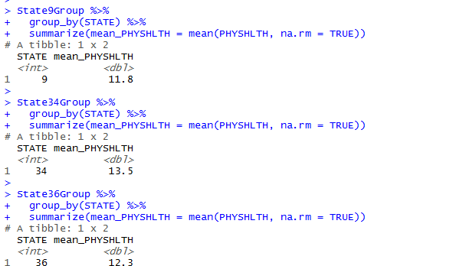
Physical Health Indication of Distribution
In order to get indication distribution we need to get two main information:-
Average number of days with bad health in past month.
Average number of days along with differ by state.
Preprocessing steps to get the information:-
Subset from dataset contains data from last month only.
Filter the induced dataset to get each state with number of bad physical days.
The Result form preprocessing:-
there are 3 states which are 9, 34, and 36.
The average number of days for stares are shown in figure

Slide 4
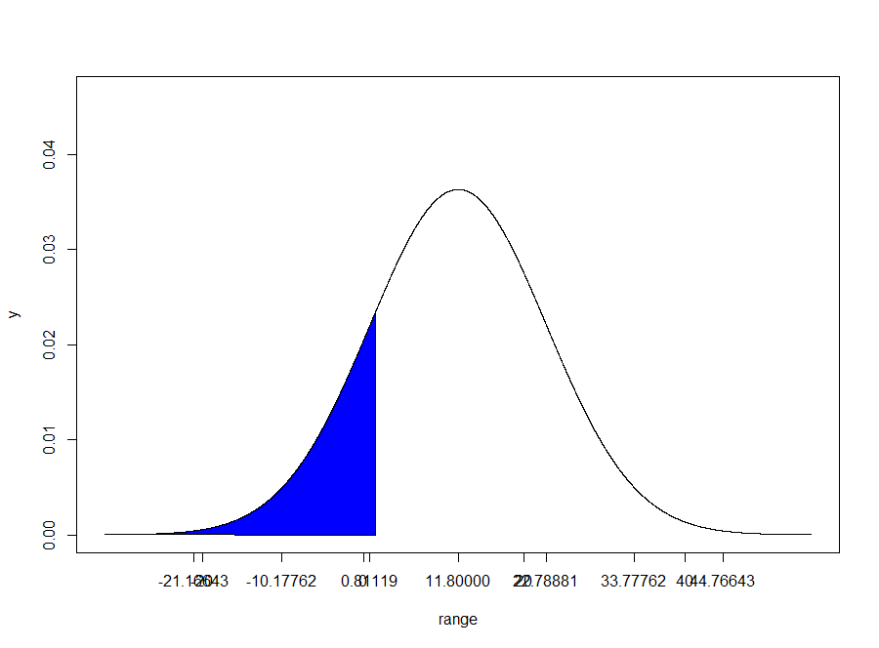
Physical Health Indication of Distribution
Starting with normal distribution for state 9:-
The mean =11.8
The figure shows the normal distribution for state 9. it has probability of 17.4% ( the blue area) is below average day of not good health days.

Slide 5
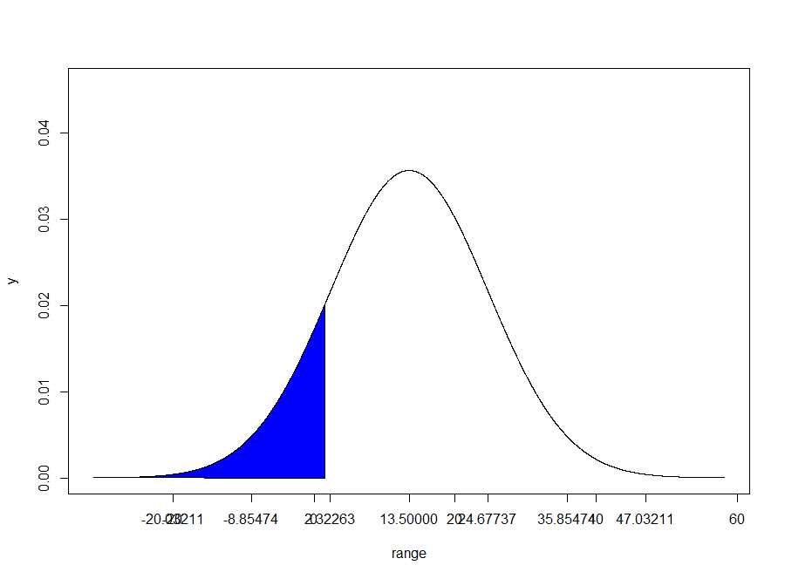
Physical Health Indication of Distribution
Normal distribution for state 34:-
The mean =13.5
The figure shows the normal distribution for state 34. it has probability of 14.1% ( the blue area) is below average day of not good health days.

Slide 6
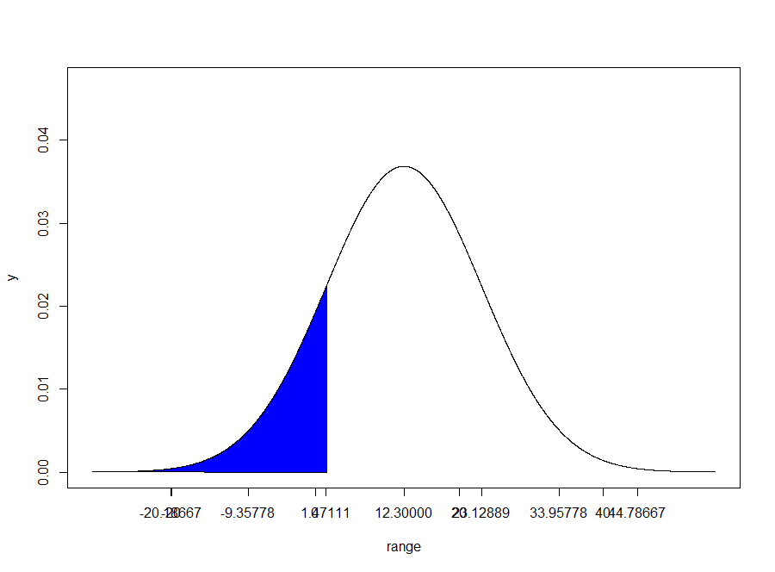
Physical Health Indication of Distribution
Normal distribution for state 36:-
The mean =12.3
The figure shows the normal distribution for state 36. it has probability of 15.9% ( the blue area) is below average day of not good health days.

Slide 7
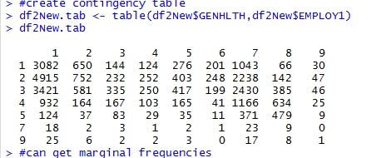
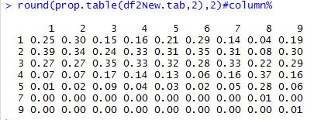
Factors that impact on Health
In order to determine factors from demographic, behaviors, and previous illness have impact/dependent of general health or not. The result will be introduced using Cross Tabulation and Chi Square test.
Starting with the impact of employee status on general health (demographics):-
from contingency table the largest number of people that are in good health are employed for wages and largest number of people that have poor health are unable to work, with column percentage they are about 25% and 28%.
the Pearson's Chi-squared test equals X-squared = 5153.6, df = 48, p-value < 2.2e-16.
We did Chi-Squared test to see the variation between health categories. So according to p-value which is less than alpha= 0.05 ,there is difference between general health categories.

Slide 8
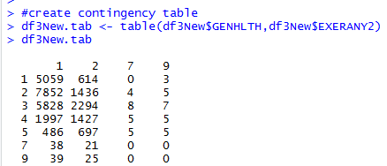
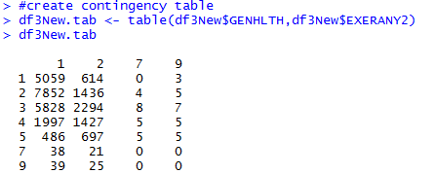
Factors that impact on Health
Checking person physical activities and its impact of general health "Behaviors":-
from contingency table the largest number of people that are in good health are who do physical activities and largest number of people that have good, and fair health don’t do physical, with column percentage they are about 24% and 22%-35%.
the Pearson's Chi-squared test equals X-squared = 2454.8, df = 18, p-value < 2.2e-16.

Slide 9
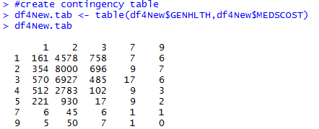
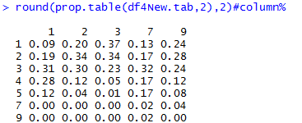
Factors that impact on Health
checking that person did not take medication because of cost during.
last 12 months and its impact of general health "Previous illness“.
from contingency table and percentages showed that the largest number of people that are in good health are who took medication regardless its cost.
the Pearson's Chi-squared test equals X-squared = 1372.7, df = 24, p-value < 2.2e-16.

Slide 10
Recommendations
The national health related institute should collaborate with bureau of labor to review and evaluate the injuries and disorder. They could conduct studies of incentive/disincentives to injury and illness or disorder reporting should be conducted with the end in mind of surveillance system reform.
Psrogram should be conducted to provide systematic and substantial understanding of the effects of potentially harmful workplace exposures on individual and population outcomes among older workers with existing chronic conditions, both during periods of employment and after retirement.
Research should be undertaken to assess the full (direct and indirect) costs of older workers' occupational injuries and illnesses or disorders to individuals, families, and society
Research should be conducted to build a culture of health to increase rate for fitness to improve health with support of their work communities.

